Slide 1
Evaluation of the Course (Modified)
Course work: 30%
  Four assignments (30%)
    7.5 5 points for each of the first two three assignments
    15 points for the last assignment
A final exam: 70%
115/11/08
CS4335 Design and Analysis of Algorithms /Shuai Cheng Li
Page <number>

Slide 2
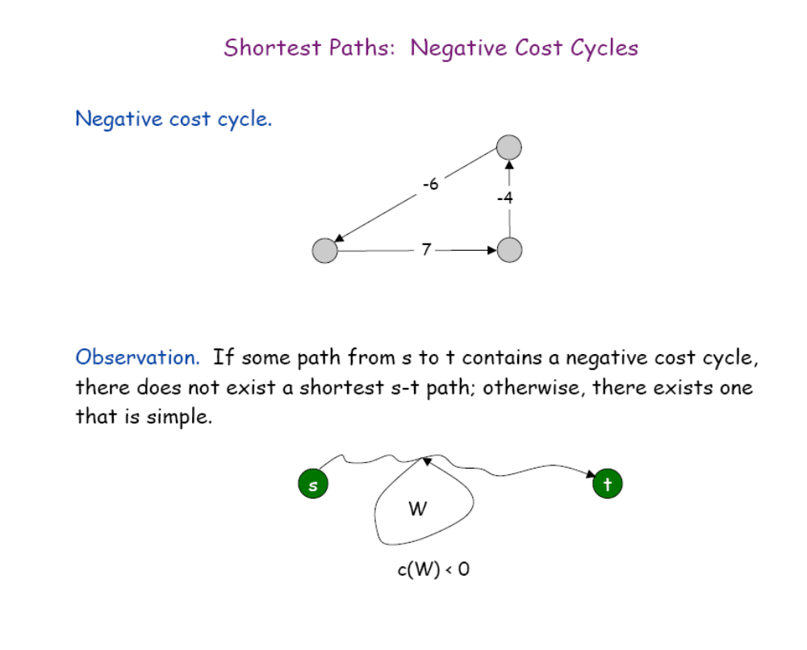
Single source shortest path with negative cost edges
chapter25

Slide 3
Single source shortest path with negative weight edges
Input: An weight graph (V, E, W), where the weight on edges can be negative, a source vertex s, and a destination vertex v.
Task: Find a shortest path from the source to v.
115/11/08
CS4335 Design and Analysis of Algorithms /Shuai Cheng Li
Page <number>

Slide 4
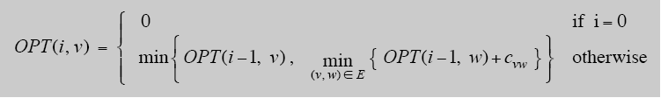
Shortest Paths: Dynamic Programming
Def. OPT(i, v)=length of shortest s-v path P using at most i edges.
Case 1: P uses at most i-1 edges.
  OPT(i, v) = OPT(i-1, v)
Case 2: P uses exactly i edges.
  If (w, v) is the last edge, then OPT use the best s-w path using at most i-1 edges and edge (w, v).
  Remark: if no negative cycles, then OPT(n-1, v)=length of shortest s-v path.
∞
s
Cwv
w
v
chapter25
OPT(0, s)=0.

Slide 5
Shortest Paths: implementation
Shortest-Path(G, t) {
for each node v ∈ V
M[0, v] = ∞
M[0, s] = 0
for i = 1 to n-1
for each node w ∈ V
M[i, w] = M[i-1, w]
for each edge (w, v) ∈ E
M[i, v] = min { M[i, v], M[i-1, w] + c_{wv} }
}
Analysis. O(mn) time, O(n²) space.
m--no. of edges, n—no. of nodes
Finding the shortest paths. Maintain a "successor" for each table entry.
chapter25

Slide 6
Shortest Paths: Practical implementations
Practical improvements.
Maintain only one array M[v] = shortest v-t path that we have found so far.
No need to check edges of the form (w, v) unless M[w] changed in previous iteration.
Theorem. Throughout the algorithm, M[v] is the length of some s-v path, and after i rounds of updates, the value M[v] ≤ the length of shortest s-v path using ≤ i edges.
Overall impact.
Memory: O(m + n).
Running time: O(mn) worst case, but substantially faster in practice.
chapter25

Slide 7
Bellman-Ford: Efficient Implementation
Push-Based-Shortest-Path(G, s, t) {
for each node v ∈ V {
M[v] = ∞
successor[v] = empty
}
M[s] = 0
for i = 1 to n-1 {
for each node w ∈ V {
if (M[w] has been updated in previous iteration) {
for each node v such that (w, v) ∈ E {
if (M[v] > M[w] + cwv) {
M[v] = M[w] + cwv
successor[v] = w
}
}
}
If no M[w] value changed in iteration i, stop.
}
}
Note: Dijkstra’s Algorithm select a w with the smallest M[w] .
Time O(mn), space O(n).
chapter25

Slide 8
u
5
v
8
8
-2
6
-3
8
s
0
7
-4
2
7
8
8
9
x
y
(a)
chapter25

Slide 9
u
5
v
6
8
-2
6
-3
8
s
0
7
-4
2
7
7
8
9
x
y
(b)
chapter25

Slide 10
u
5
v
6
4
-2
6
-3
8
s
0
7
-4
2
7
7
2
9
x
y
(c)
chapter25

Slide 11
u
5
v
2
4
-2
6
-3
8
s
0
7
-4
2
7
7
2
9
x
y
(d)
chapter25

Slide 12
u
5
v
2
4
-2
6
-3
8
s
0
7
-4
2
7
x
7
-2
y
(e)
9
vertex: s u v x y
d: 0 2 4 7 -2
successor: s v x s u
chapter25

Slide 13
Corollary: If negative-weight circuit exists in the given graph, in the n-th iteration, the cost of a shortest path from s to some node v will be further reduced.
Demonstrated by the following example.
chapter25

Slide 14
5
∞
∞
6
1
-2
0
8
7
∞
7
9
∞
∞
2
2
5
-8
∞
∞
An example with negative-weight cycle
chapter25

Slide 15
5
6
∞
6
1
-2
0
8
7
∞
7
9
7
∞
2
2
5
-8
∞
∞
i=1
chapter25

Slide 16
5
6
11
6
1
-2
0
8
7
∞
7
9
7
16
2
2
5
-8
9
∞
i=2
chapter25

Slide 17
5
6
11
6
1
-2
0
8
7
12
7
9
7
16
2
2
5
-8
9
1
i=3
chapter25

Slide 18
5
6
11
6
1
-2
0
8
7
12
7
9
6
16
2
2
5
-8
9
1
i=4
chapter25

Slide 19
5
6
11
6
1
-2
0
8
7
12
7
9
6
15
2
2
5
-8
8
1
i=5
chapter25

Slide 20
5
6
11
6
1
-2
0
8
7
12
7
9
6
15
2
2
5
-8
8
0
i=6
chapter25

Slide 21
5
6
11
6
1
-2
0
8
7
12
7
9
5
15
2
2
5
-8
8
0
x
i=7
chapter25

Slide 22
5
6
11
6
1
-2
0
8
7
12
7
9
5
15
2
2
5
-8
7
0
x
i=8
chapter25

Slide 23
Dijkstra’s Algorithm: (Recall)
Dijkstra’s algorithm assumes that w(e)≥0 for each e in the graph.
maintain a set S of vertices such that
  Every vertex v ∈S, d[v]=δ(s, v), i.e., the shortest-path from s to v has been found. (Intial values: S=empty, d[s]=0 and d[v]=∝)
(a) select the vertex u∈V-S such that
d[u]=min {d[x]|x ∈V-S}. Set S=S∪{u}
(b) for each node v adjacent to u do RELAX(u, v, w).
Repeat step (a) and (b) until S=V.
chapter25

Slide 24




Continue:
DIJKSTRA(G,w,s):
INITIALIZE-SINGLE-SOURCE(G,s)
S
Q V[G]
while Q
do u EXTRACT -MIN(Q)
S S {u}
for each vertex v ∈ Adj[u]
do RELAX(u,v,w)
chapter25

Slide 25
u
v
1
8
8
10
9
s
0
3
4
6
2
7
5
8
8
2
x
y
(a)
chapter25
Notes:
Single Source Shortest Path Problem

Slide 26
u
v
1
10/s
8
10
9
s
0
3
4
6
2
7
5
5/s
8
2
x
y
(b)
(s,x) is the shortest path using one edge. It is also the shortest path from s to x.
chapter25

Slide 27
u
v
1
8/x
14/x
10
9
s
0
3
4
6
2
7
5
5/s
7/x
2
x
y
(c)
chapter25

Slide 28
u
v
1
8/x
13/y
10
9
s
0
3
4
6
2
7
5
5/s
7/x
2
x
y
(d)
chapter25

Slide 29
u
v
1
8/x
9/u
10
9
s
0
3
4
6
2
7
5
5/s
7/x
2
x
y
(e)
chapter25

Slide 30
u
v
1
8/x
9/u
10
9
s
0
3
4
6
2
7
5
5/s
7/x
2
x
y
(f)
Backtracking: v-u-x-s
chapter25

Slide 31
The algorithm does not work if there are negative weight edges in the graph
.
u
-10
2
v
s
1
S->v is shorter than s->u, but it is longer than
s->u->v.
chapter25

